Slide 1





A smart grid of plastics – Technical conditions for the sorting and pre-step evaluation for a “factory of the future”
Project progress
Anamaria Barrera Bogoya
03/04/2019

Slide 2
Content
Objectives
Planning
Tasks realized
Tasks in progress
Tasks to be accomplished
References

Slide 3
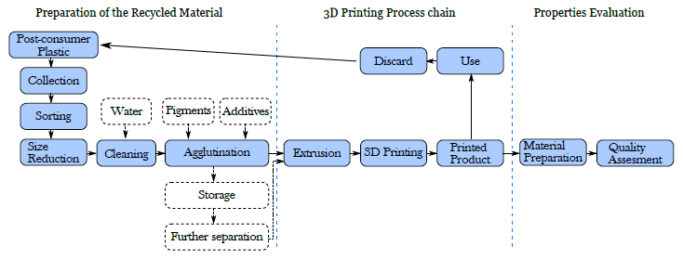
objectives
1. General context of plastics
2. Recycled plastics in 3D printing
3. Indicators implementation
4. Social component
Figure 1. Mechanical recycling process. (Sanchez, 2016)

Slide 4
Objectives : General context of plastics
Specific objectives
Find the statistics of produced, disposed and recycled plastic in Europe, France and Nancy
Determine which plastics are recycled today
Methodology
Research of statistics and data around the plastic context in databases of European statistics and published articles. In addition, conduct interviews with companies located in the area to learn about the recycling practices they are implemented and also to identify the type of plastic that is mostly discarded.
Expected results
Quantity of demanded, disposed and recycled plastic, both global and per polymer in Europe, France and Nancy.

Slide 5
Objectives : Recycled plastics in 3D printing
Specific objectives
Determine the recycled plastic(s) that may be used to produce filaments for 3D printing
Identify the protocols that are already being implemented to treat each type of plastic and establish the cost, safety, availability and feasibility that implies the implementation of each protocol.
Methodology
Two lines of bibliographic research with a systematic literature review: one of them focused on the use of recycled plastics in 3D printing and the other one on the practices and protocols that are already implemented to treat them.
Expected results
Process flow diagram of plastic conditioning protocols that can be performed in the Fablab.
Resume table of the articles found, in which the protocols effected will be summarized.

Slide 6
Objectives : Indicators implementation
Specific objectives
Identify the indicators that are used in the recycling process to measure the quality of the plastic received in the Fablab and the plastic at the end of the conditioning process that can be determined at Fablab.
Find the limits of acceptability of these indicators for the recycling process.
Propose the necessary protocols to realize the indicators measurement.
Methodology
Systematic literature research to identify indicators that are currently used in plastic recycling process.
Expected results
A flow diagram with indicator measurement protocols that will be incorporated into the process flow diagram obtained from the previous point.

Slide 7
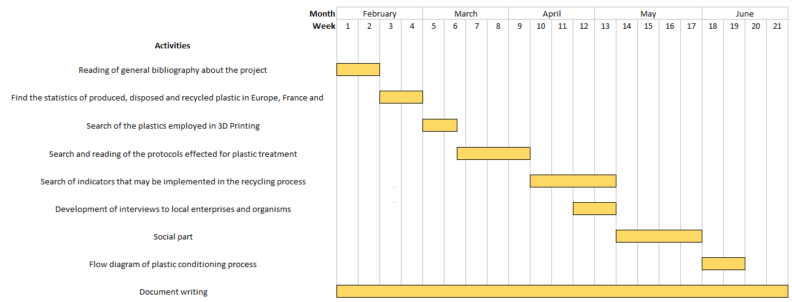
planning

Slide 8
Tasks realized
1. Literature review about:
1.1. Additive Manufacturing
1.2. Plastics commonly recycled and recycled plastics employed in 3D Printing (systematic literature review)
1.3. Plastic recycling methods (mechanical recycling)
2. Search of data about generation, disposition and recycling plastic wastes in Europe, France and Nancy in European databases (Eurostat) and national and regional reports (European Commission, Bio Intelligence Service, PlasticsEurope, Plastics Recyclers and Deloitte)

Slide 9
Tasks realized: literature review
1.1. Additive Manufacturing
Additive Manufacturing is a technique that has the principle of producing parts layer by layer in a free-form fabrication process.
Fused Deposition Modelling is the most common method of 3D Printing. This process usually uses thermoplastic polymer filaments that are heated until a temperature slightly higher than the melting temperature at the nozzle of the machine, reaching a semi-liquid state.
Main drawbacks | Main benefits
Poor surface quality Low speed production High costs Reduced mechanical properties than in other technologies | Possibility to close the plastic loop. The technology availability and affordability are growing No additional tools are required for parts production Mass customization Mass production of complex geometries

Slide 10
Tasks realized: literature review
1.2. Plastics commonly recycled (A) and recycled plastics employed in 3D Printing (B)
PET: Polyethylene terephthalate
HDPE: High-density polyethylene
LDPE: Low-density polyethylene
PP: Polypropylene
PS: Polystyrene
PC: Polycarbonate
ABS: Acrylonitrile butadiene styrene
PVC: Polyvinyl chloride
PLA: Polylactic acid
PEF: Polyethylene furanoate
PVC
PET
HDPE
LDPE
PP PLA
PS PEF
PC
ABS
A
B

Slide 11
Tasks realized: literature review
1.3. Plastic recycling methods
Primary recycling: Mechanical operations that cause physical changes to plastic waste in order to produce a new generation of products which usually have the same purpose as the original material
Secondary recycling (mechanical recycling): In this process the polymer structure remains unchanged because of the physical operations to which plastic is subjected, such as separation and sorting (size, color, shape, density or chemical composition), bailing, washing, grinding and pelletizing.
Tertiary recycling (chemical recycling): Consist in the polymer decomposition to their constitutive monomers or other valuable low molecular weight fragments, so that it is possible to repolymerized them and synthetize the original or a new plastic
Quaternary recycling (energy recovery): Refers to a combustion process which is performed in order to produce electricity and district heating. This process is convenient because of its high efficiency (above 90%) and yield due to their high calorific capacity.

Slide 12
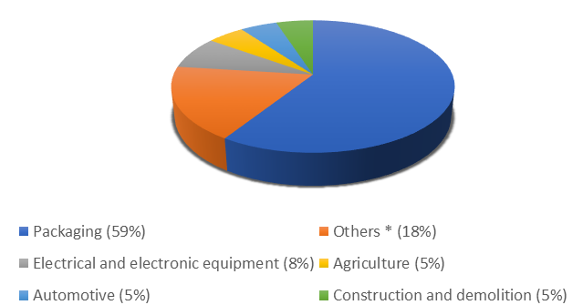
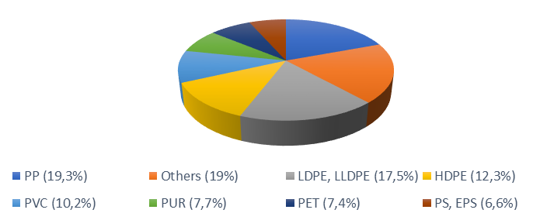
Tasks realized: statistics Europe
2. Statistics of generation, treated and recycled plastic wastes
Figure 2. European plastic converter demand in 2017. (Plastics Europe, 2018)
Figure 3. Plastic waste generation in Europe in 2015. (European Commission, n.d.)
* Consumer and household appliances, furniture, sport, health and safety

Slide 13
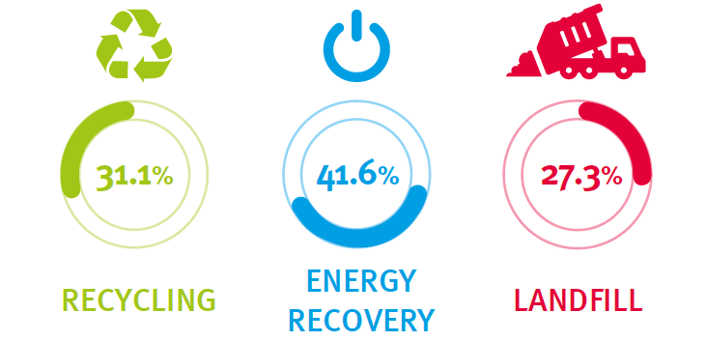
Tasks realized: statistics Europe
2. Statistics of generation, treated and recycled plastic wastes
Figure 4. Plastic resins content in European waste streams in 2012. (Hestin, Faninger, & Milios, 2016)
Figure 5. Statistics of plastic waste treatment in Europe in 2016. (Plastics Europe, 2018)

Slide 14
Tasks realized: statistics France
2. Statistics of generation, treated and recycled plastic wastes
Figure 6. Waste treatment in France in 2016. (Eurostat, n.d.)
Figure 7. Plastic flows in France in 2012. (Deloitte. ADEME, 2014)

Slide 15
Tasks realized: statistics Nancy
2. Statistics of generation, treated and recycled plastic wastes
Figure 8. Collected tonnes in Nancy in 2017. (GrandNancy, 2017)
Figure 9. Recycled tonnes in Nancy in 2017. (GrandNancy, 2017)

Slide 16
Tasks in progress : literature review of mechanical recycling process
Search strategy | Type of documents | Journal articles and conference paper
 | Keywords | “Mechanical recycling” “Plastic”, “Thermoplastic”, “Polymer” “Polyethylene terephthalate”, PET…
 | Equation search in title, abstract and key words | (mechanical recycling ) AND (plastic OR thermoplastic OR polymer) AND ((polyethylene terephthalate) OR PET)
 | Period of time | 2009 – 2019
 | Sources of information | Scopus, Web of Science, Science Direct
Study selection | Criteria | Articles describing conceptually or experimentally the mechanical recycling process realized to plastic material

Slide 17
Tasks in progress : literature review of mechanical recycling process
Data extraction | Identification data | Title DOI
 | Pre-step procedures | Material Flow treated Sorting (Technique, conditions, desired conditions) Shredding (Technique, conditions, desired conditions) Cleaning (Technique, conditions, desired conditions) Drying (Technique, conditions, desired conditions) Size separation (Technique, conditions, desired conditions) Use of compatibilizers Costs
 | Sustainable dimensions | Technical Economical Social Environmental
 | Evaluation | Before recycling After recycling Use of indicators

Slide 18
Tasks to be accomplished
Bibliographic research about indicators used for quality evaluation of plastic
Definition of general and specific objectives linked with social part
Development of interviews to local enterprises and organisms
Flow diagram of plastic conditioning process
Use of R for statistical plots generation
Keywords analysis in VOSviewer
Final document

Slide 19
References (some of them)
Deloitte. ADEME. (2014). Analyse de la chaîne de valeur du recyclage des plastiques en France - Synthèse. Retrieved from https://www.ademe.fr/sites/default/files/assets/documents/analyse-chaine-de-valeur-recyclage-plastiques-en-france-201412-synthese.pdf
Despeisse, M., Baumers, M., Brown, P., Charnley, F., Ford, S. J., Garmulewicz, A., … Rowley, J. (2017). Unlocking value for a circular economy through 3D printing : A research agenda. Technological Forecasting & Social Change, 115, 75–84. https://doi.org/10.1016/j.techfore.2016.09.021
European Comission. (n.d.). A European strategy for plastics in a circular economy. Retrieved from http://ec.europa.eu/environment/circular-economy/pdf/plastics-strategy-brochure.pdf
European Commission. (2011). Plastic waste in the environment. Retrieved from http://ec.europa.eu/environment/waste/studies/pdf/plastics.pdf
European Comission. (2019). A circular economy for plastics. https://doi.org/10.2777/269031
Eurostat. (n.d.). Eurostat Database. Retrieved from https://ec.europa.eu/eurostat/web/waste/data/database
GrandNancy. (2017). Rapport annuel 2017. Retrieved from https://en.calameo.com/read/002074474b9e4866fc95f
Hestin, M., Faninger, T., & Milios, L. (2016). Increased EU Plastics Recycling Targets : Environmental , Economic and Social Impact Assessment Final Report Prepared for Plastic Recyclers Europe. Retrieved from https://www.plasticsrecyclers.eu/sites/default/files/BIO_Deloitte_PRE_Plastics Recycling Impact_Assesment_Final Report.pdf
Horodytska, O., Valdés, F. J., & Fullana, A. (2018). Plastic flexible films waste management – A state of art review. Waste Management, 77, 413–425. https://doi.org/10.1016/j.wasman.2018.04.023
Ligon, S. C., Liska, R., Gurr, M., Mu, R., Gmbh, H. B. F. D., Bleiche, A. D. R., & D-, L. (2017). Polymers for 3D Printing and Customized Additive Manufacturing. https://doi.org/10.1021/acs.chemrev.7b00074
Ngo, T. D., Kashani, A., Imbalzano, G., Nguyen, K. T. Q., & Hui, D. (2018). Additive manufacturing ( 3D printing ): A review of materials , methods , applications and challenges. Composites Part B, 143(February), 172–196. https://doi.org/10.1016/j.compositesb.2018.02.012
Okan, M., Aydin, H. M., & Barsbay, M. (2018). Current approaches to waste polymer utilization and minimization : a review Meltem Okan , a Halil Murat Aydin b and Murat Barsbay c * STATE AND CONVENTIONAL METHODS OF, (May). https://doi.org/10.1002/jctb.5778
Paulraj, S., Hait, S., & Thakur, A. (2017). A review on automated sorting of source-separated municipal solid waste for recycling. Waste Management, 60, 56–74. https://doi.org/10.1016/j.wasman.2016.09.015
Plastics Europe. (2018). Plastics – the Facts 2018. Retrieved from https://www.plasticseurope.org/application/files/6315/4510/9658/Plastics_the_facts_2018_AF_web.pdf
Ragaert, K., Delva, L., & Geem, K. Van. (2017). Mechanical and chemical recycling of solid plastic waste. Waste Management, 69, 24–58. https://doi.org/10.1016/j.wasman.2017.07.044
Sanchez, F. A. C. (2016). Methodological proposition to evaluate polymer recycling in open-source additive manufacturing contexts Doctoral Dissertation.
Wendel, B., Rietzel, D., Ku, F., Feulner, R., & Schmachtenberg, E. (n.d.). Additive Processing of Polymers, 799–809. https://doi.org/10.1002/mame.200800121
Zander, N. E., Gillan, M., & Lambeth, R. H. (2018). Recycled polyethylene terephthalate as a new FFF feedstock material. Additive Manufacturing, 21(January), 174–182. https://doi.org/10.1016/j.addma.2018.03.007

